Slide 1
BINSENSE : OPTIMIZED WASTE MANAGEMENT
Software Development Project (MCA251)
CIA 2
By
Vishal S [2447259]
R Sharanya [2447241]
Under the Supervision of
Dr. Sudhakar T
CHRIST (Deemed to be University)

Slide 2
CONTENT
1. Introduction
2. Need analysis
3. Social impact
4. Alignment with SDG goals
5. Existing systems and Limitations
6. Proposed work and advantages
7. Requirement description
8. Analysis modelling
i) Circuit diagram
ii) Architecture diagram
iii) Use Case Diagrams
iv) Data Flow Diagrams (DFDs) and Entity-Relationship Diagrams (ERDs)
v) Sequence Diagrams
9. Project plan
10. Expected Outcome

Slide 3
INTRODUCTION
BINSENSE: Optimized Waste Management System is an IoT-based solution designed to address urban waste management challenges. Using ultrasonic sensors, it tracks bin fill levels and sends data to a cloud platform, enabling real-time monitoring and optimized collection routes. This reduces unnecessary trips, cuts costs, and lowers the pollution. By leveraging IoT technology, BINSENSE improves operational efficiency, reduces costs, and enhances urban cleanliness. BINSENSE transforms traditional waste management into a proactive, environmentally friendly system with easy access.

Slide 4
NEED ANALYSIS
Overflowing Bins: Inconsistent monitoring leads to overflowing bins, causing environmental pollution and health hazards.
Inefficient Collection: Delays in waste collection result in resident dissatisfaction and higher operational costs.
Manual Monitoring Challenges: Traditional methods are labor-intensive, prone to errors, and lack real-time data.
Resource Wastage: Inefficient route planning leads to unnecessary fuel consumption and increased carbon emissions, unnecessary use of materials such as garbage bags, gloves, etc.
Growing Urbanization: Rapid urban growth demands smarter, scalable waste management solutions.
Cost Reduction: Automating waste management can significantly lower labor and operational expenses.

Slide 5
SOCIAL IMPACT
Enhanced Public Health and Hygiene
By ensuring timely waste collection, BINSENSE minimizes the risk of waste overflow, reducing exposure to harmful bacteria and pests. This leads to a significant decrease in disease outbreaks caused by unsanitary conditions. Cleaner surroundings promote a healthier living environment for communities.
Increased Community Awareness
The project integrates smart technology, raising awareness about the importance of waste segregation and sustainable disposal methods. Public engagement in waste management fosters a sense of responsibility towards environmental conservation. This cultural shift encourages long-term adoption of eco-friendly habits.
Improved Quality of Life
Cleaner streets and public areas result in a more pleasant and visually appealing environment, enhancing the overall quality of life. Reduced waste-related issues, such as odor and pollution, make urban areas more livable. This project also contributes to creating safer, healthier neighborhoods, boosting community pride.

Slide 6
Other Social Impacts…
Cost Savings for Local Authorities
Optimized waste collection systems reduce the operational costs of waste management for municipalities.
Reduction in Pollution
Efficient waste monitoring minimizes littering and pollution in public spaces, leading to a healthier environment.
Empowerment Through Technology
Leverages technology to empower communities, giving them the tools to manage waste efficiently.

Slide 7
ALIGNMENT WITH SDG GOALS
SDG 3: Good Health and Well-being
Reduces health risks related to poor waste management, leading to improved public health outcomes.
SDG 9: Industry, Innovation, and Infrastructure
The use of IoT and smart technology in waste management promotes innovation in urban infrastructure.
SDG 11: Sustainable Cities and Communities
The project contributes to creating more sustainable and resilient cities by optimizing waste management and reducing waste-related hazards.
SDG 12: Responsible Consumption and Production
Promotes efficient use of resources and reduces waste, encouraging sustainable consumption and production patterns.
SDG 15: Life on Land
Reduces pollution and waste on land, contributing to the protection of ecosystems and biodiversity.

Slide 8
EXISTING SYSTEMS AND LIMITATIONS
Manual Waste Collection:
Limitation: Relies on scheduled pickups without real-time data, leading to overflowing bins or unnecessary trips.
Problem: Inefficient routes result in wasted time, fuel, and increased carbon emissions.
Sensor-Based Waste Monitoring (Traditional):
Limitation: Uses basic sensors to detect the type of waste, allowing for its segregation.
Problem: The use of basic sensors for waste type detection may lead to inaccurate classification, affecting the efficiency of waste segregation.

Slide 9
Bin Weight Measurement Systems:
Limitation: Systems relying on weight sensors may fail to accurately measure bin fill levels, leading to inefficiencies.
Problem: Weight-based measurements can be influenced by factors like compacted waste or the type of materials, providing inaccurate results.
Centralized Waste Management Control:
Limitation: Centralized decision-making systems that don’t consider live conditions or dynamic urban factors.
Problem: Lack of flexibility and adaptability to real-time situations leads to suboptimal collection schedules and routes.

Slide 10
PROPOSED WORK
The proposed work for the BINSENSE: Optimized Waste Management System aims to enhance urban waste management using advanced IoT technology.
The system utilizes ultrasonic sensors to monitor real-time fill levels of waste bins, providing data on waste accumulation. This data is transmitted to a cloud platform (blynk) where it is analyzed to optimize waste collection routes, ensuring timely pickups and minimizing fuel consumption. A dedicated website will serve as a central hub for monitoring and updating all system data, including waste bin statuses. This platform will provide waste management teams with real-time insights and allow users to track system progress.
By implementing this solution, waste management operations will become more efficient, cost-effective, and environmentally friendly. Additionally, the integration of predictive analytics will help anticipate waste accumulation patterns, enabling better resource allocation and further reducing unnecessary waste collection trips. This proactive approach aligns with sustainability goals and contributes to a cleaner, more efficient urban environment.

Slide 11
ADVANTAGES
Efficient Waste Collection
Environmental Impact
Cost Saving
Scalability
User-Friendly Interface
The system reduces unnecessary collection trips, minimizing fuel consumption and operational costs for waste management teams.
By monitoring bin fill levels in real-time, the system ensures timely collection, reducing overflowing bins and optimizing waste collection routes.
Optimizing routes and reducing fuel use helps lower the carbon footprint of waste collection vehicles, contributing to cleaner air and fewer emissions.
The IoT-based system is easily scalable, making it adaptable to different urban environments and capable of managing increased waste volumes as cities grow.
The website provides a user-friendly interface for monitoring and updating the system, offering real-time access to waste management data and performance.

Slide 12
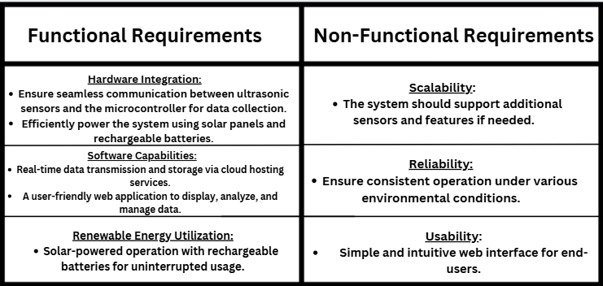
REQUIREMENT DESCRIPTION

Slide 13
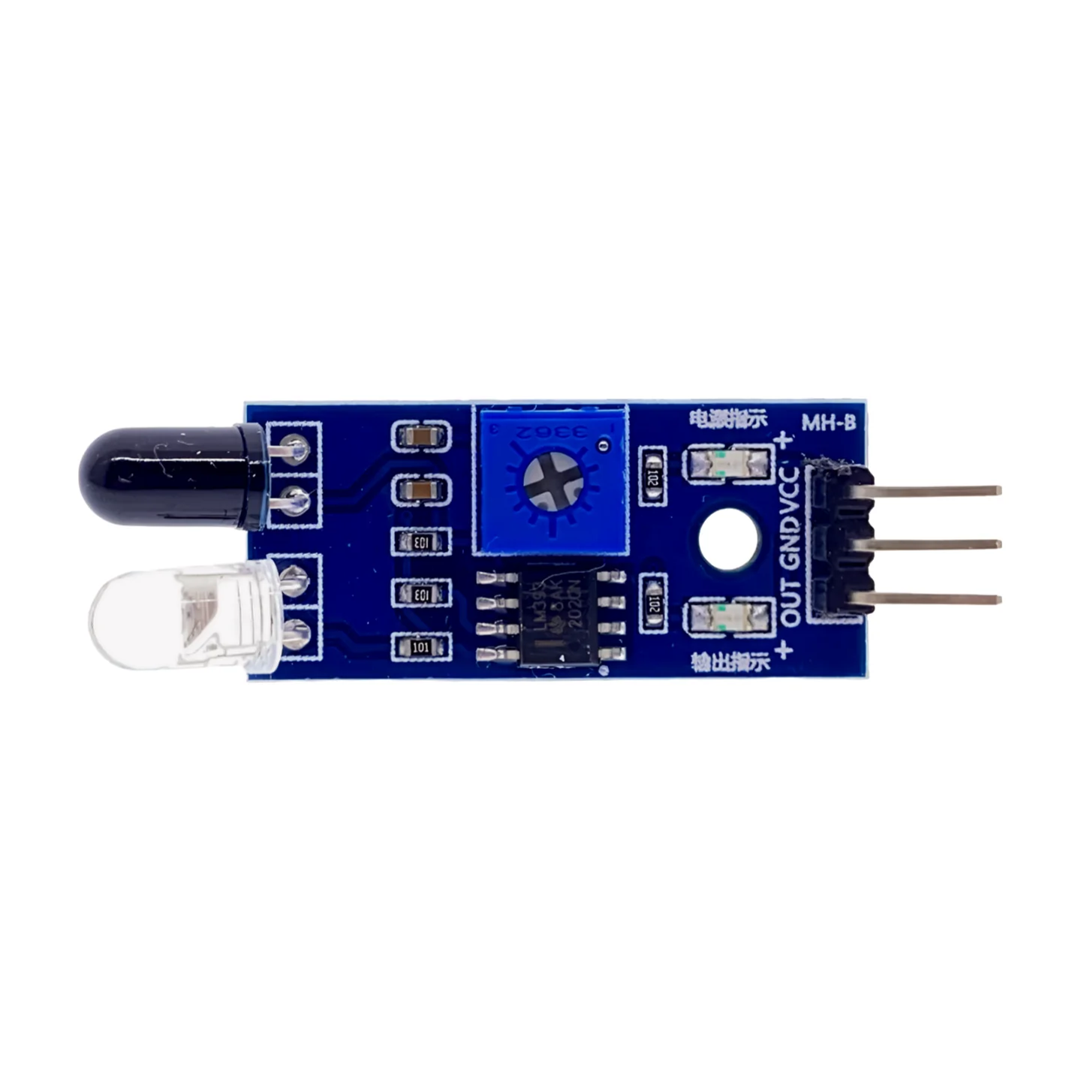
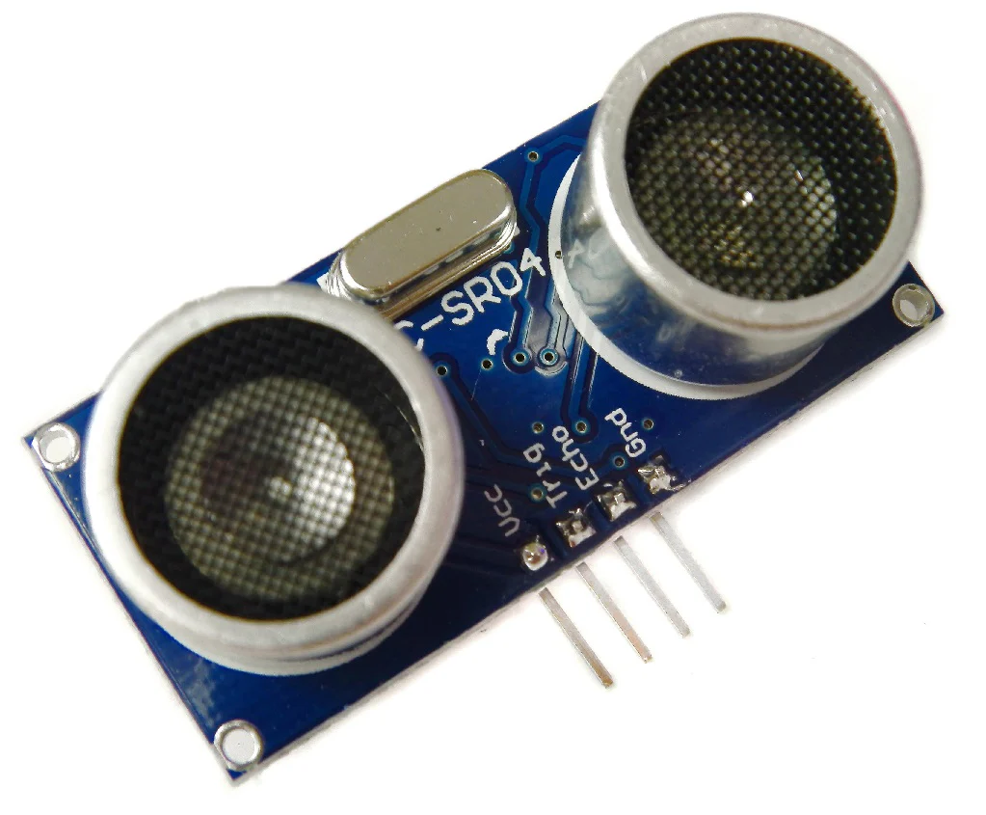
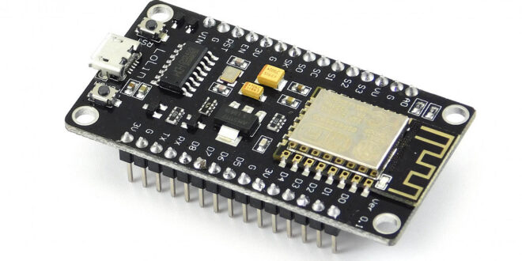
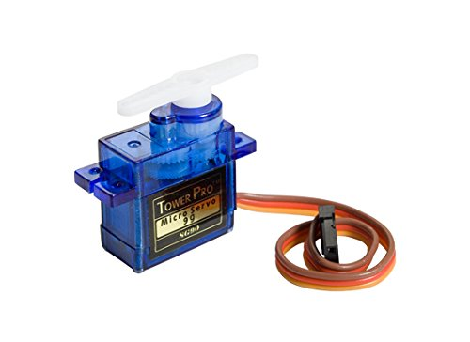
Components
Esp8266 UltraSonic Sensor IR Sensor
Servo Motor

Slide 14
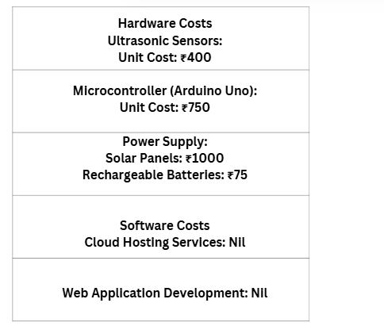
Cost Analysis Summary

Slide 15
ANALYSIS MODELLING

Slide 16
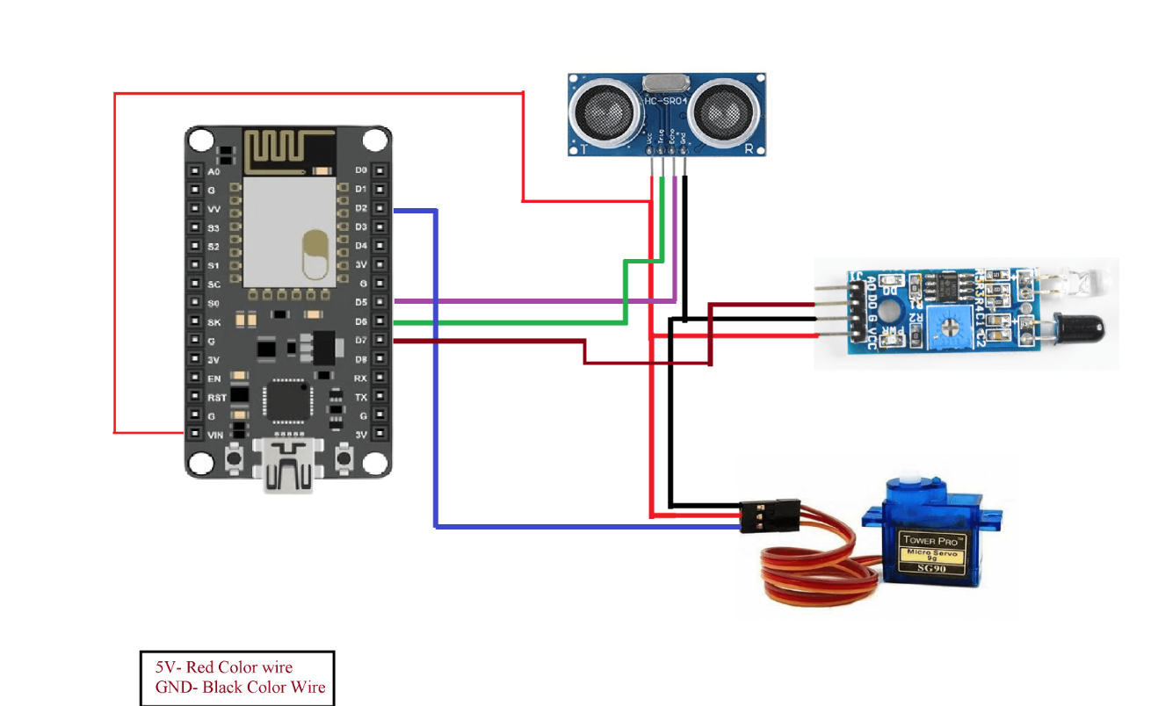
Circuit Diagram

Slide 17
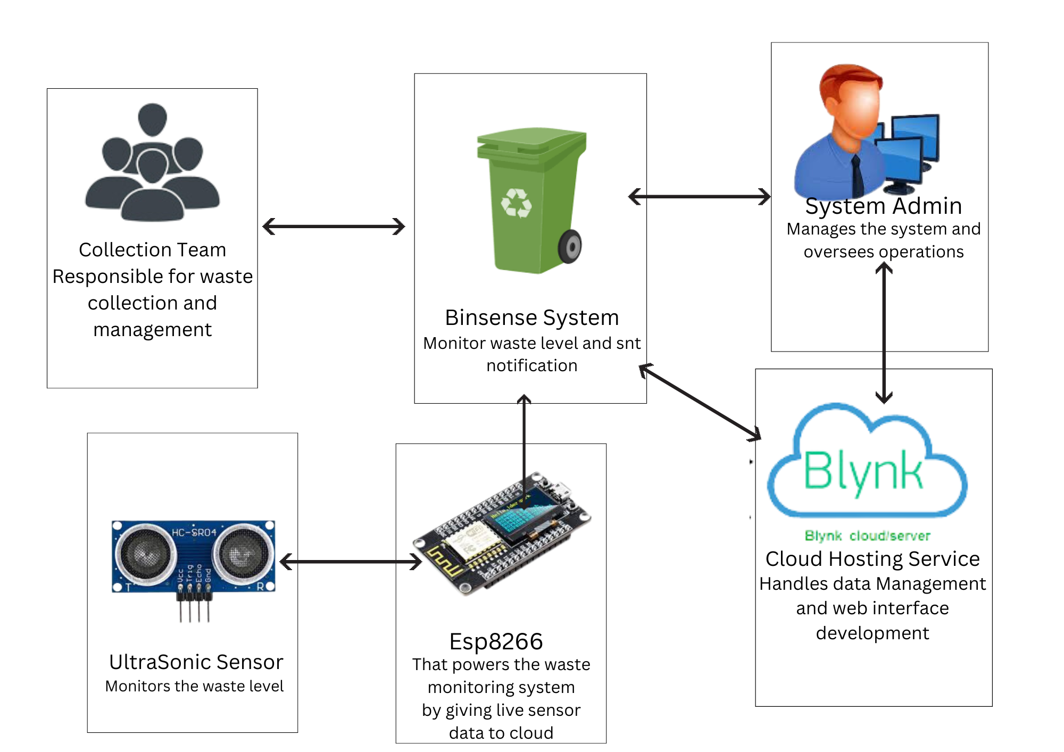
Architecture diagram

Slide 18
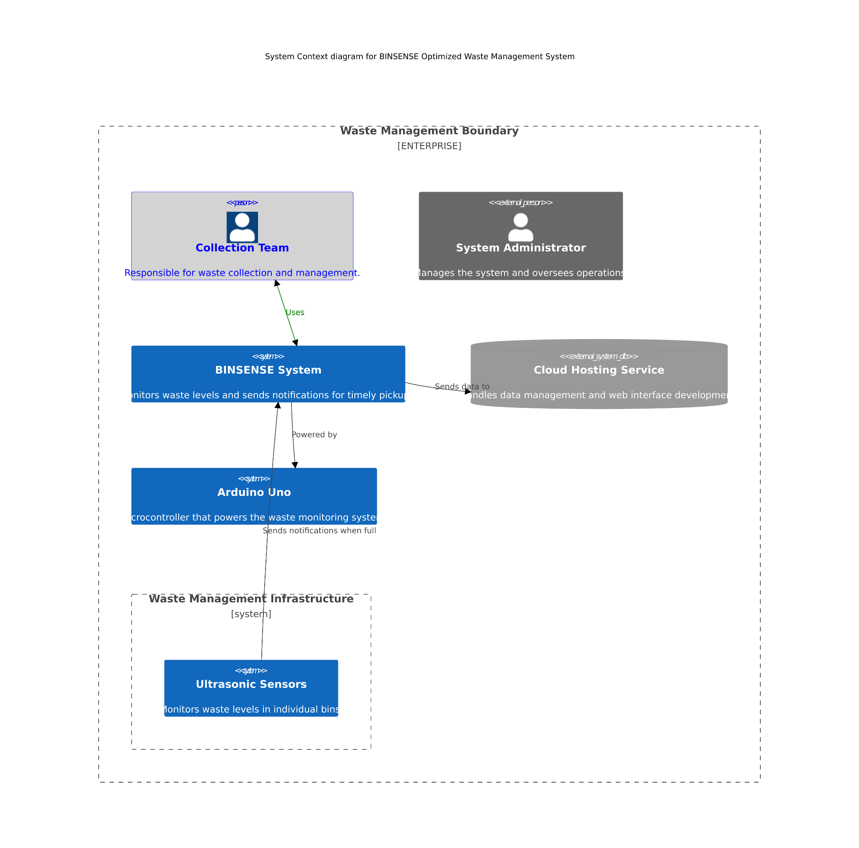
Architecture diagram

Slide 19
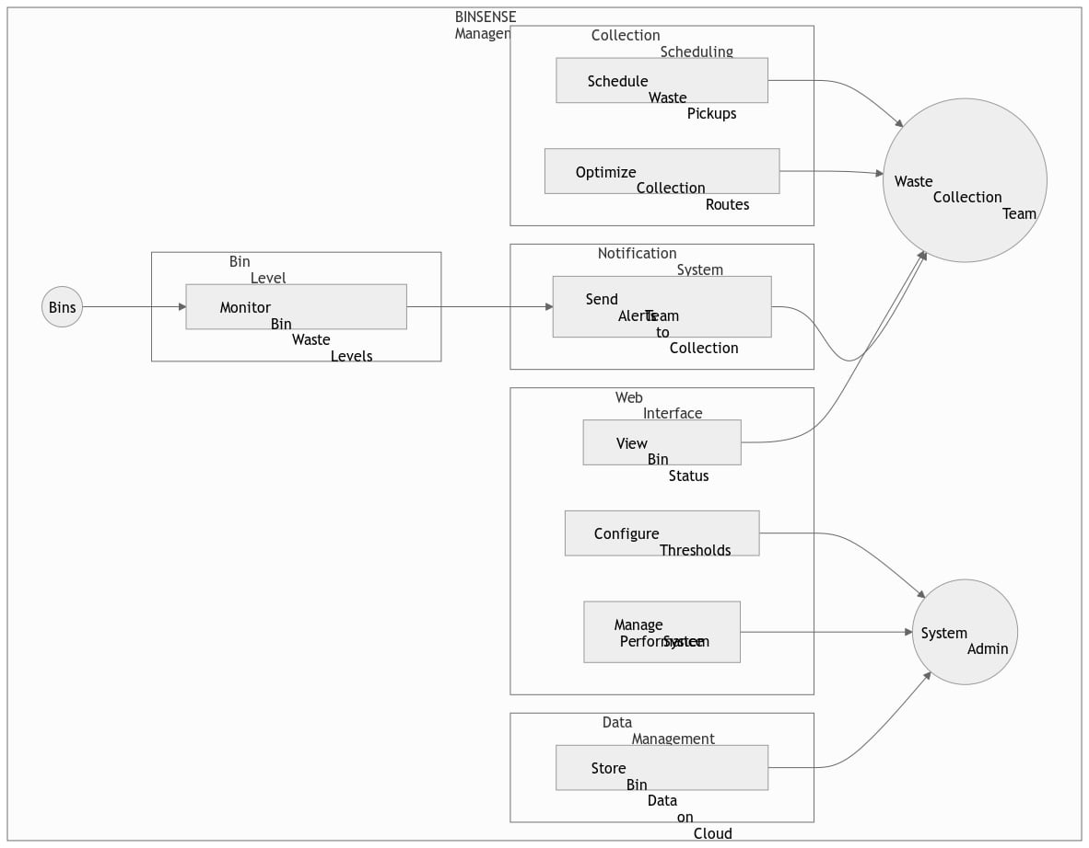
Use Case Diagrams

Slide 20
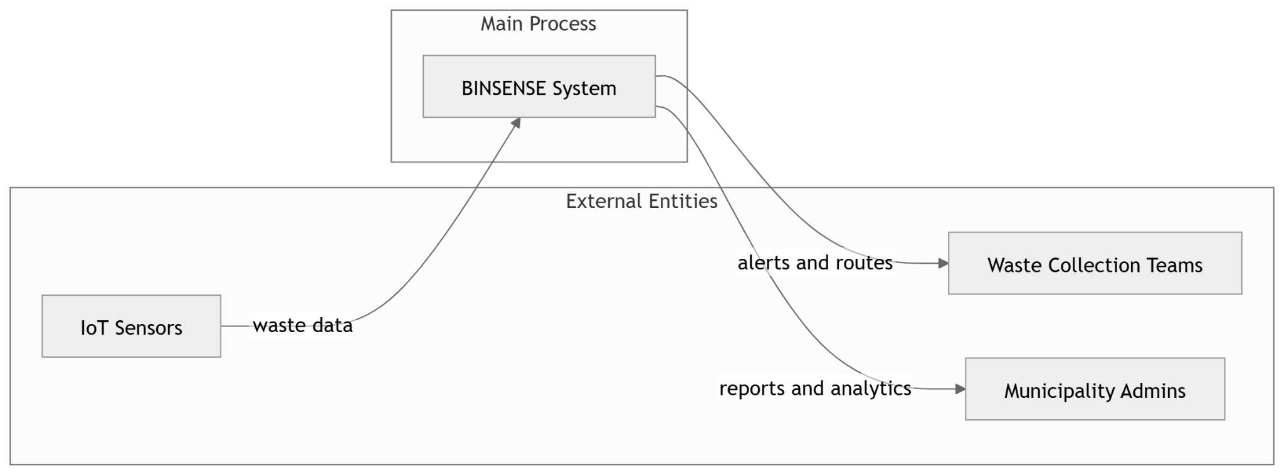
Data Flow Diagrams (DFDs)
LEVEL 0 DFD

Slide 21
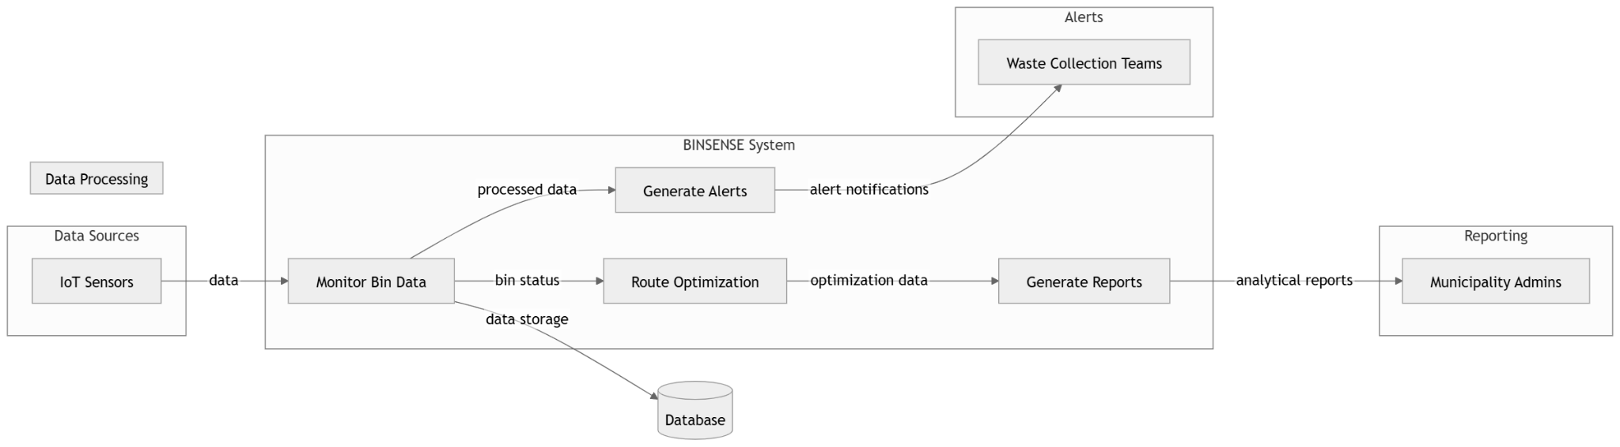
LEVEL 1 DFD

Slide 22
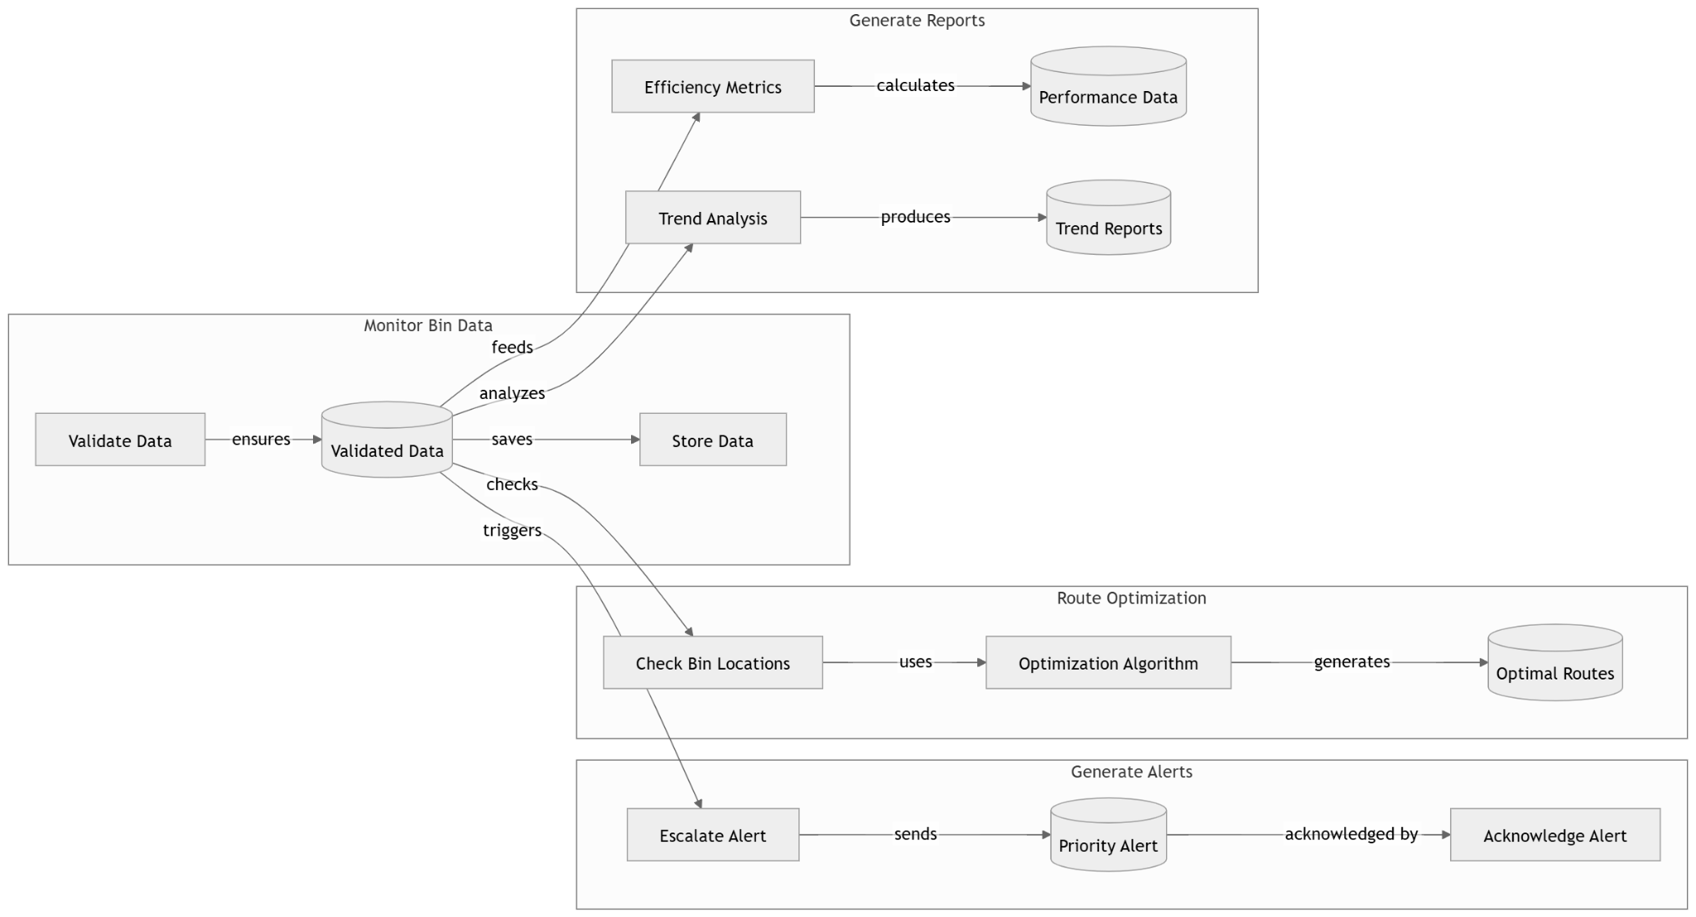
LEVEL 2 DFD

Slide 23
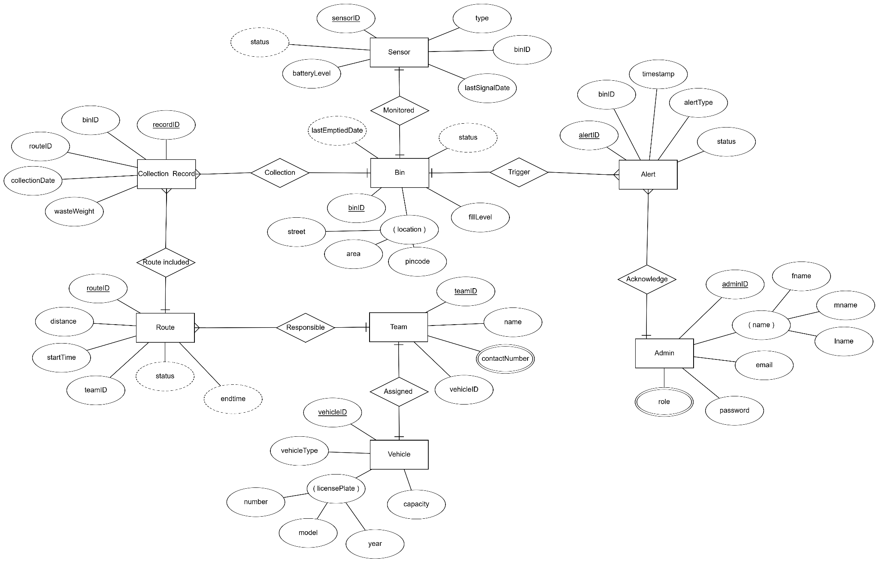
Entity-Relationship Diagram

Slide 24
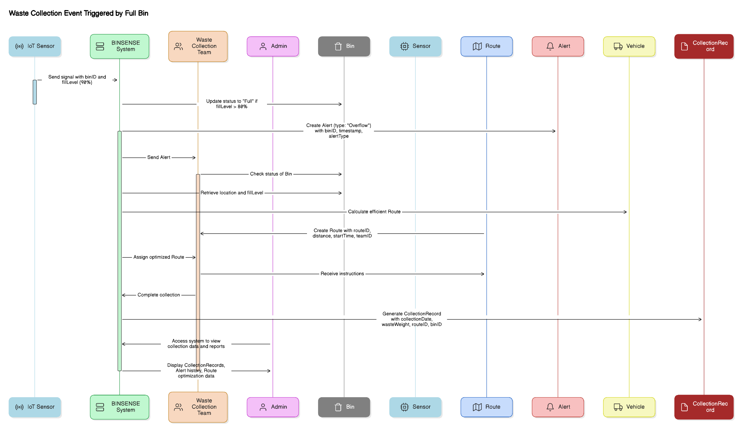
Sequence Diagram

Slide 25
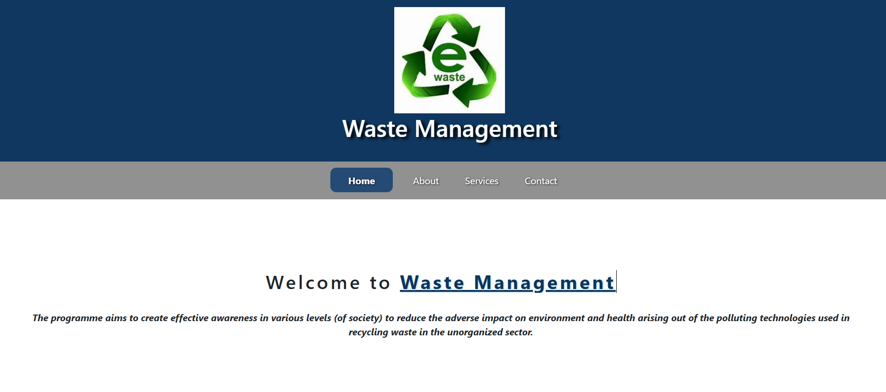
UI- Implementation (Screenshots)

Slide 26
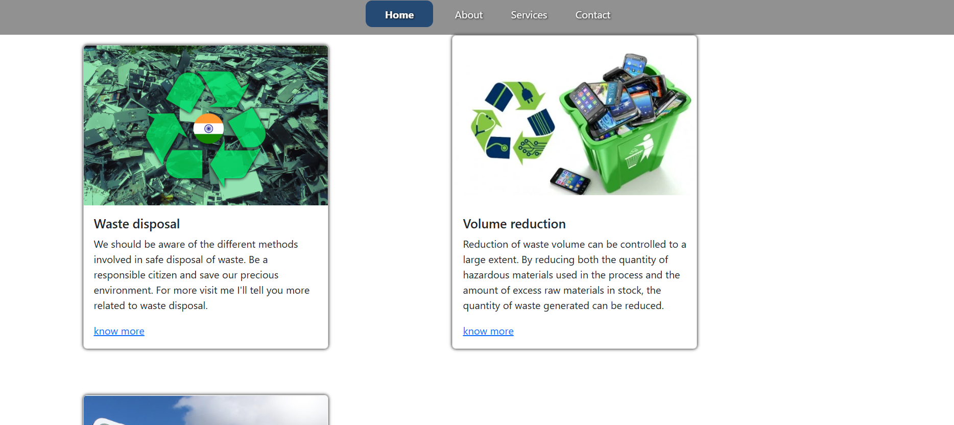

Slide 27
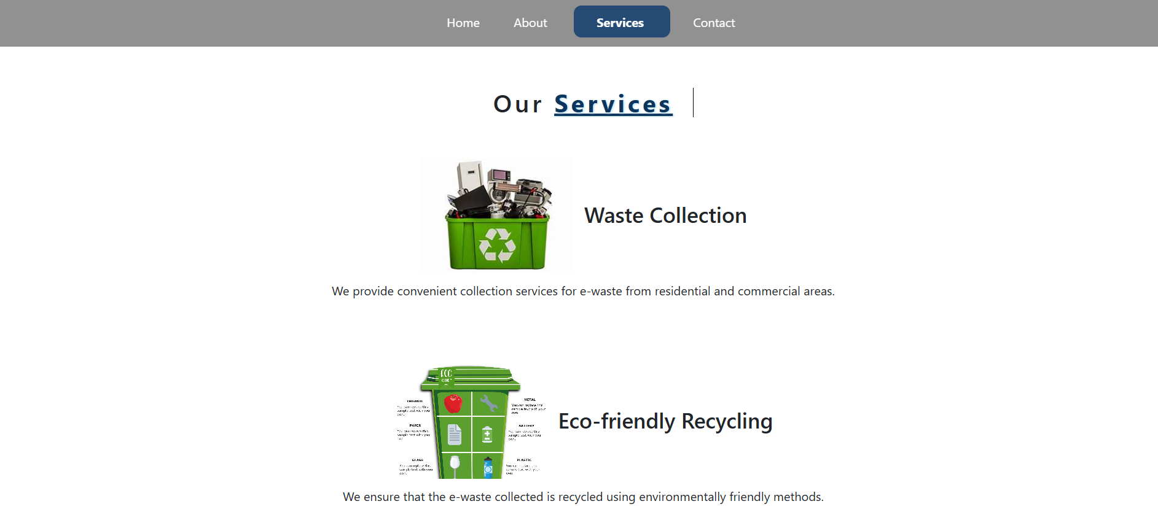

Slide 28
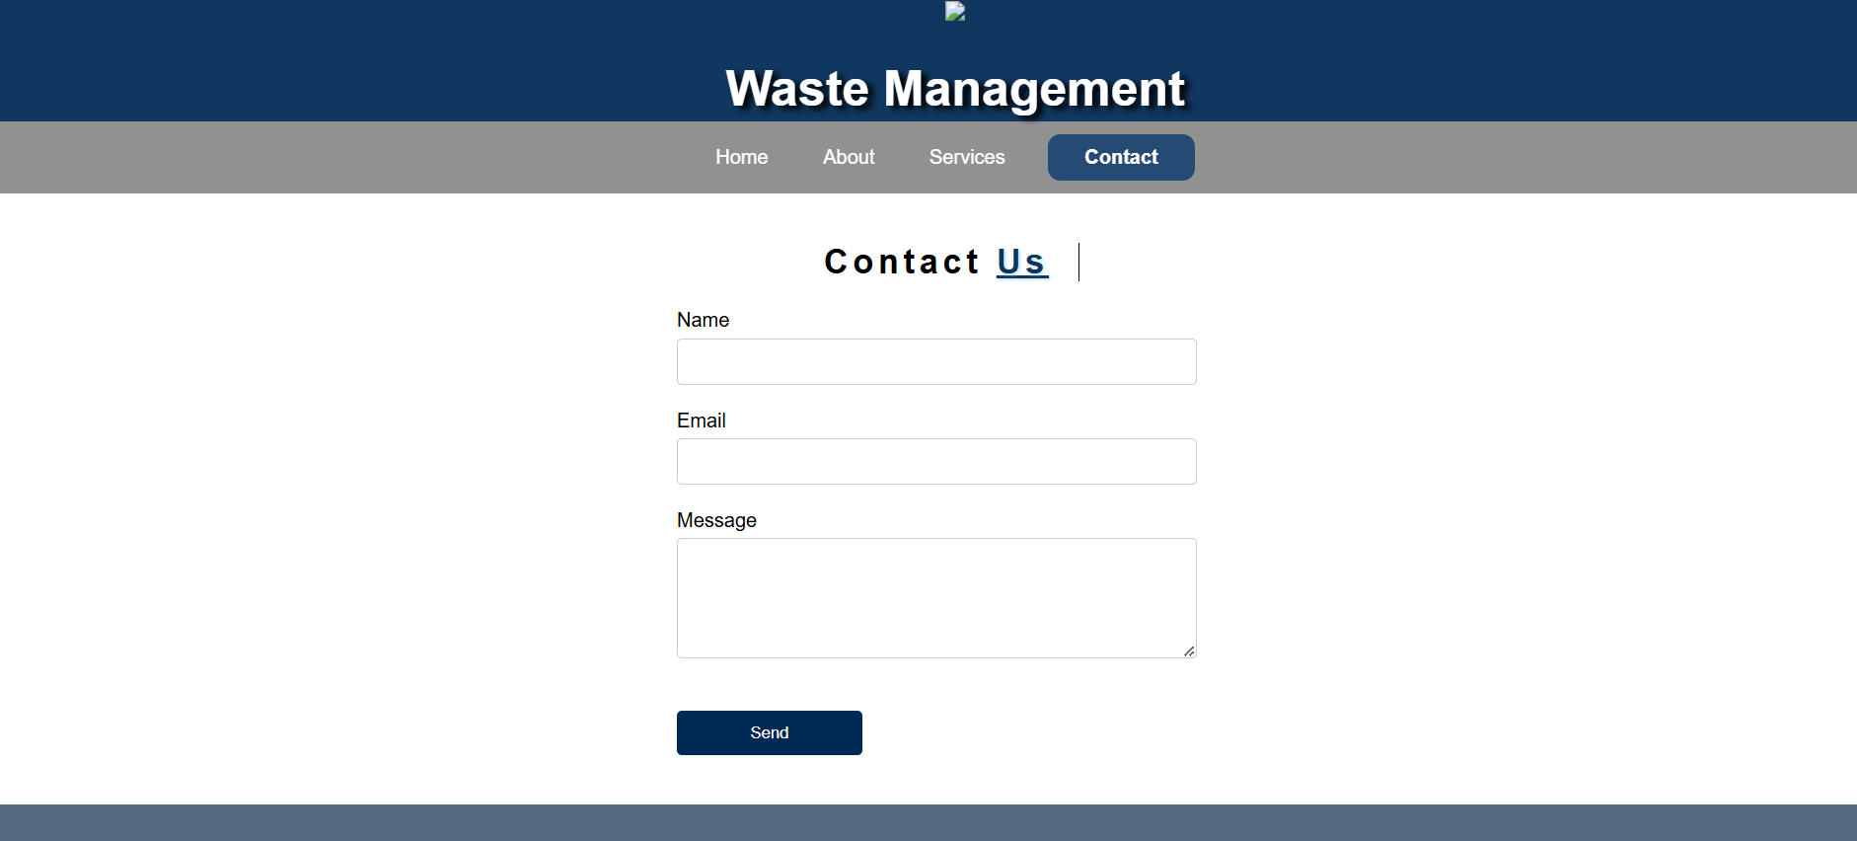

Slide 29
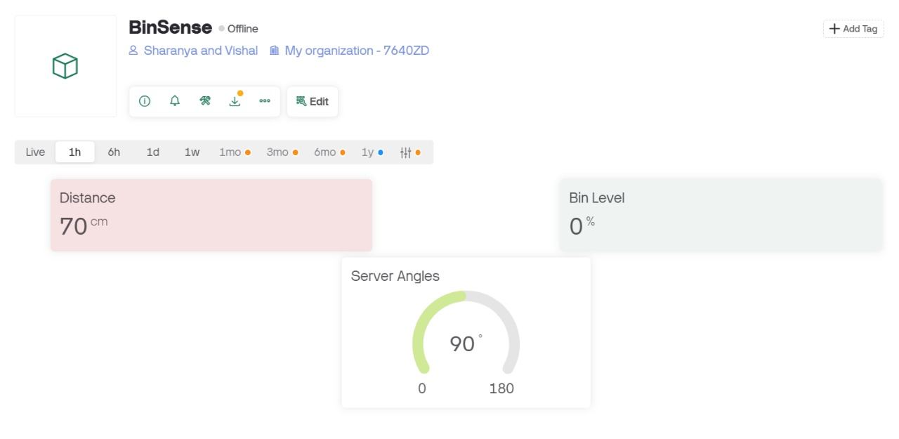
Dashboard

Slide 30
PROJECT PLAN
BINSENSE Project Timeline: December 2024 - June 2025
Project Initialization – Defining scope, assembling the team, and setting up communication channels.
Research & Development – Exploring IoT hardware, cloud platforms, and developing a prototype.
System Design – Creating hardware, cloud, database, and UI/UX design architectures.
Development Phase – Integrating sensors, setting up data transmission, and developing the web platform.
Testing & Validation – Conducting unit, integration, and system testing to ensure performance accuracy.
Deployment & Launch – Installing sensors, deploying the system, and conducting final performance checks.
Project Closure – Reviewing outcomes, collecting feedback, and preparing for post-launch support.

Slide 31
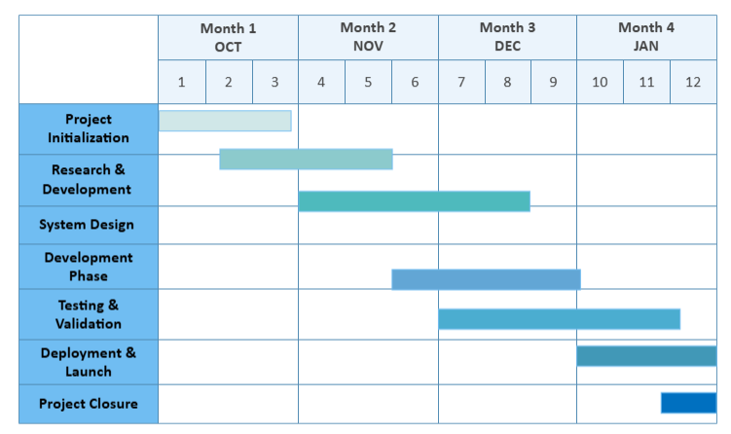
Gantt Chart

Slide 32
EXPECTED OUTCOME
BINSENSE IoT-Enabled Waste Management Model
A complete IoT system integrating ultrasonic sensors and microcontrollers to monitor waste levels in real-time.
Cloud-based infrastructure for data storage, processing, and optimized route planning using real-time data analytics.
Automated alert system for timely waste collection, reducing operational costs and environmental impact.
BINSENSE Web Platform
A user-friendly web dashboard for waste management teams to track real-time bin statuses, analyze historical data trends, and configure system settings.
Public-facing website section for sharing live updates, collection schedules, and environmental impact reports, promoting transparency and public engagement.

Slide 33
REFERENCES
United Nations. (2015). Transforming Our World: The 2030 Agenda for Sustainable Development. United Nations General Assembly. Available at: https://sdgs.un.org/2030agenda
Bala, G., & Siddhartha, D. (2021). IoT-based Smart Waste Management System: A Comprehensive Review. International Journal of Environmental Science and Technology, 18(2), 421-435. doi:10.1007/s13762-021-03197-w
AWS IoT Documentation. (2023). Connecting Devices to AWS IoT Platform. Amazon Web Services. Available at: https://docs.aws.amazon.com/iot/
Arduino Documentation. (2023). Getting Started with Arduino Microcontrollers. Arduino. Available at: https://docs.arduino.cc/
Singh, R., & Rathore, V. S. (2022). A Survey on Smart Waste Management Systems Using IoT and Cloud Technologies. Journal of Environmental Management, 301, 113804. doi:10.1016/j.jenvman.2021.113804
Ravindra, P., & Gupta, A. (2020). Urban Waste Collection Optimization Using IoT-Based Monitoring and Sensor Networks. IEEE Access, 8, 56324-56334. doi:10.1109/ACCESS.2020.2987098

Slide 34
Thank You

